Slide 1

Topics
•
Creating
Your
Own
Packages
in
Java
1
Object-Oriented Programming Using Java

Slide 2
Packages Introduction
•
Packages enable grouping of functionally related
classes
Package names are dot separated, e.g., java.lang.
Package names have a correspondence with the
directory structure
Packages Avoid name space collision. There can not
•
•
•
be two classes with same name in
a same Package.
But two packages can have a class with same name.
•
Exact Name of the
structure. << Fully
java.lang.String ;
class is identifed by its package
Qualified
Name>>
java.util.Arrays;
java.util.Date
java.io.BufferedReader ;
2
Object-Oriented Programming Using Java

Slide 3
Creating Your Own Packages
•
•
Packages are mirrored through directory structure.
To
create a
package,
First
we
have
to
create
a
directory
/directory
structure that
matches
the
package hierarchy.
•
To
make
a class
belongs
to
a
particular
package
include
the <<package>>
statement
as
the
first
statement of source file.
Note that Outer classes can have public or
•
package-
private scope. Nested Classes can have any scope
A source .java file can have only one <<package>>
statement. Also note that only one class be public in
a source .java file.
•
3
Object-Oriented Programming Using Java

Slide 4
Creating Your
Example
Own
Package
:
mypackage
mypackageA
mypackageB
S1,S2,S3
S4,S5,S6
ABC
DEG
IJK
XYZ
A,B,C
Package ABC
D,E,F
A,B,C,I,J,K
X,Y,Z
C) with same name.
and IJK have three classes (A,B and
A class in ABC has name mypackage.mypackageA.ABC.A
A class in IJK has name mypackage.mypackageB.IJK.A
4
Object-Oriented Programming Using Java

Slide 5
Creating Your Own Package :
Example ….
Step
1:
Create
a
Directory Structure That
Matches
Your
Package
Structure
mypackage
mypackageA
mypackageB
ABC
DEG
IJK
XYZ
5
Object-Oriented Programming Using Java

Slide 6
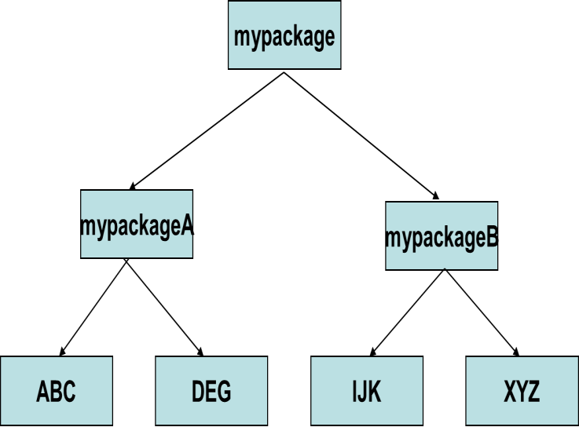
Creating Your Own
Example ….
Package :
Make class S1 belongs to
scope
// File Name : S1.java
mypackageA
with
public
package mypackage.mypackageA;
public class S1
{
public S1( )
{
System.out.println("This is Class S1");
} // End of Constructor
} // End of class S1
S1
Name the source file as S1.java and compile it.
Store the generated S1.class file in mypackageA
directory
6
Object-Oriented Programming Using Java

Slide 7
Creating Your Own
Example ….
Package :
Make class S2 belongs to
scope
// File Name : S2.java
mypackageA
with
public
package mypackage.mypackageA;
public class S2
{
public S2( )
{
System.out.println("This is Class S2");
} // End of Constructor
} // End of class S2
S1 S2
Name the source file as S2.java and compile it.
Store the generated S2.class file in mypackageA directory
7
Object-Oriented Programming Using Java

Slide 8
Creating Your Own Package :
Example ….
Make class A belongs to IJK with
public
scope
// File Name : A.java
package mypackage.mypackageB.IJK;
public class A
{
public A( )
{
");
S1,S2
System.out.println("This is Class A in IJK
} // End of Constructor
} // End of class A
Name the source file as A.java and compile it.
Store the generated A.class file in IJK directory
A
<< Repeat the Same Procedure for Other classes >>
8
Object-Oriented Programming Using Java

Slide 9
Importing the Packages
•
•
import statement allows the importing of package
JRE looks at two places for user created packages
1.
Under the current working directory from
executing your program
At the location specified by CLASSPATH
variable
where you are
2.
environment
•
Most ideal location
immediately above
for compiling/executing
a
program
is
the
package
structure.
9
Object-Oriented Programming Using Java

Slide 10
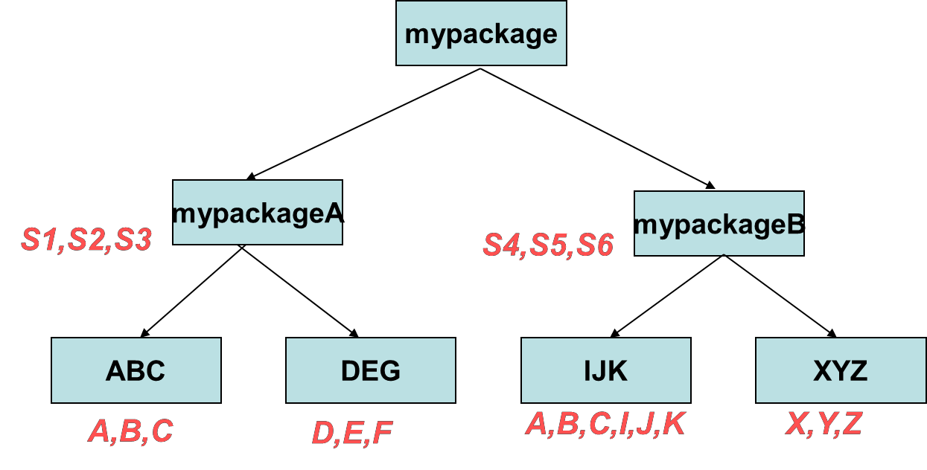
Importing the Packages
Suppose you want to use the classes A and
B
from
ABC
package
// File Name : Test.java
import mypackage.mypackageA.ABC.*;
class Test
{
public static void main(String args[])
{
B b1 = new B(); C c1 = new C();
} // End of Method
} // End of class Test
Store the Test.java File in a
that is immediately above the
location
package
above
structure
i.e.
in
a folder
mypackage.
from there.
Compile
and
Execute
it
10
Object-Oriented Programming Using Java

Slide 11

What is the Error in the
Following Code?
import mypackage.mypackageA.ABC.*;
Import mypackage.mypackageB.IJK.*;
class Test
{
public static void main(String args[])
{
A a1 = new A();
} // End of Method
} // End of class Test
class A is present in both the imported packages ABC and IJK.
So class A has to referred via its fully qualified name.
mypackage.mypackageA.ABC.A a1 = new mypackage.mypackageA.ABC.A();
OR
mypackage.mypackageB.IJK.A a1 = new mypackage.mypackageB.IJK.A();
11
Object-Oriented Programming Using Java

Slide 12
Package access can be done in three possible ways:
1.Import statement
2.Inheritance(Extending the imported class)
3.Using fully qualified name
Thank
You
12
Object-Oriented Programming Using Java

